Slide 1

Arabic Font Recognition System
Team 4 – CMPS450

Slide 2
CMPS451 – Big Data
Team Members
Ahmed Emad Reda | 1190180 | Hla Hany Mohamed | 1190344
Nada Tarek | 1180504 | Ziad Ahmed Hamed | 4200002

Slide 3
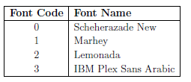
Problem Description
Objective: Develop a system to classify Arabic paragraphs into four font categories based on input images.
Challenges: Characterizing unique font features; handling variations in writing styles, spacing, and noise.

Slide 4
Project Pipeline
Data Loading & Splitting
Preprocessing
Feature Extraction
Feature Selection
Model Development
Prediction
Hyperparameter Tuning

Slide 5
Preprocessing Module
Median Filter
Image Sharpening
Conversion to Binary
Image Deskewing
Image Resizing

Slide 6
Feature Extraction & Selection Modules
Standardization
PCA
HOG
SIFT

Slide 7
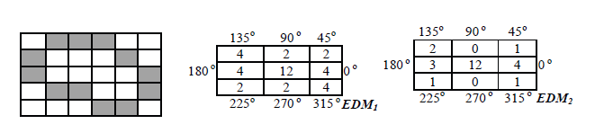
Unsuccessful Trials
Edge Direction Matrix (EDM):
Features from EDM1 & EDM2:
Edges Direction
Homogeneity
Pixel Regularity
Edges Regularity
Accuracy obtained: 85%

Slide 8
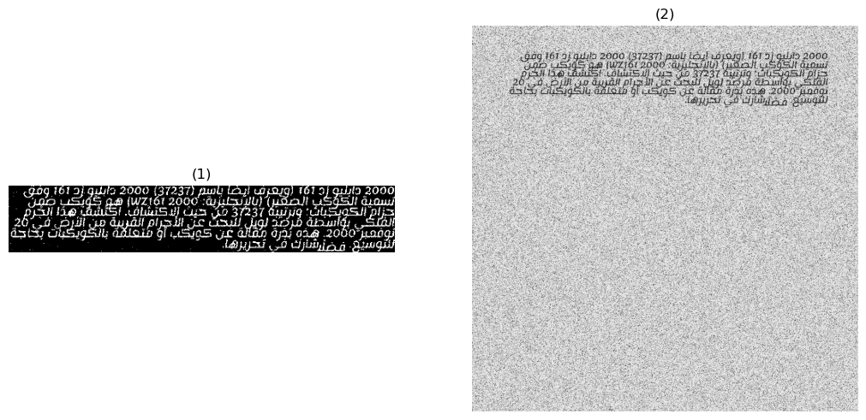
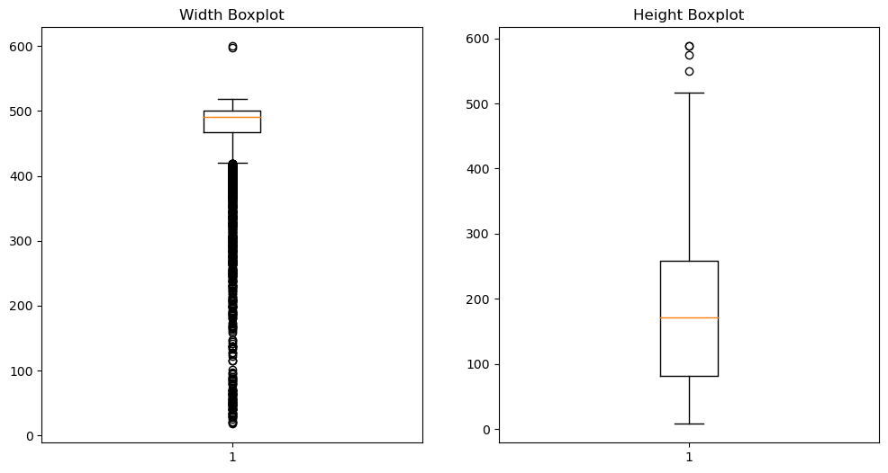
Unsuccessful Trials
Segmentation technique (inspired by Variance Threshold by scikit-learn)
Dimensions of images after segmentation
After segmentation
Before segmentation

Slide 9
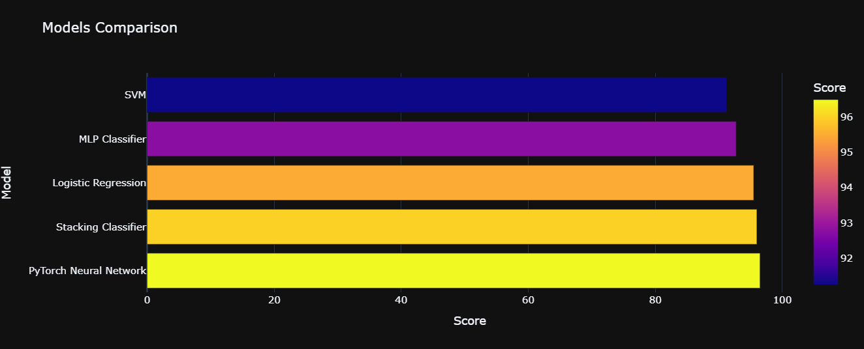
Performance Analysis

Slide 10
Model Development
PyTorch Neural Network
- Input layer processes feature vectors.
- 2 hidden layers learn complex patterns with ReLU activation.
- Output layer generates class probabilities with softmax activation.
Accuracy obtained: 96.5%
Model Architecture Summary:

Slide 11
Workload Distribution
Team member | Tasks
Ahmed Emad | Preprocessing, Model Development, API
Hla Hany | EDM, Model Development, Deployment
Nada Tarek | HOG, SIFT, PCA
Ziad Ahmed | Preprocessing, Model Development, API

Slide 12

Thank you!

